Slide 1
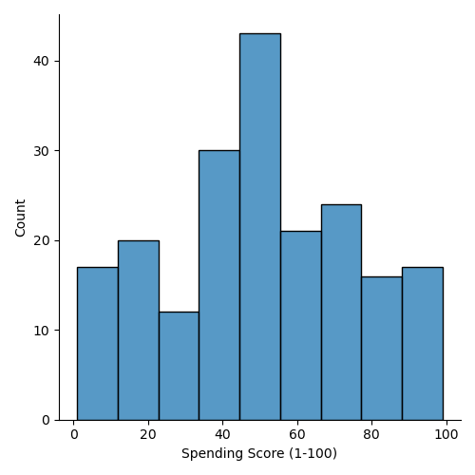
CLUSTERING UNIVARIATE COLUMNS BY HISTPLOT()_DISTPLOT()

Slide 2
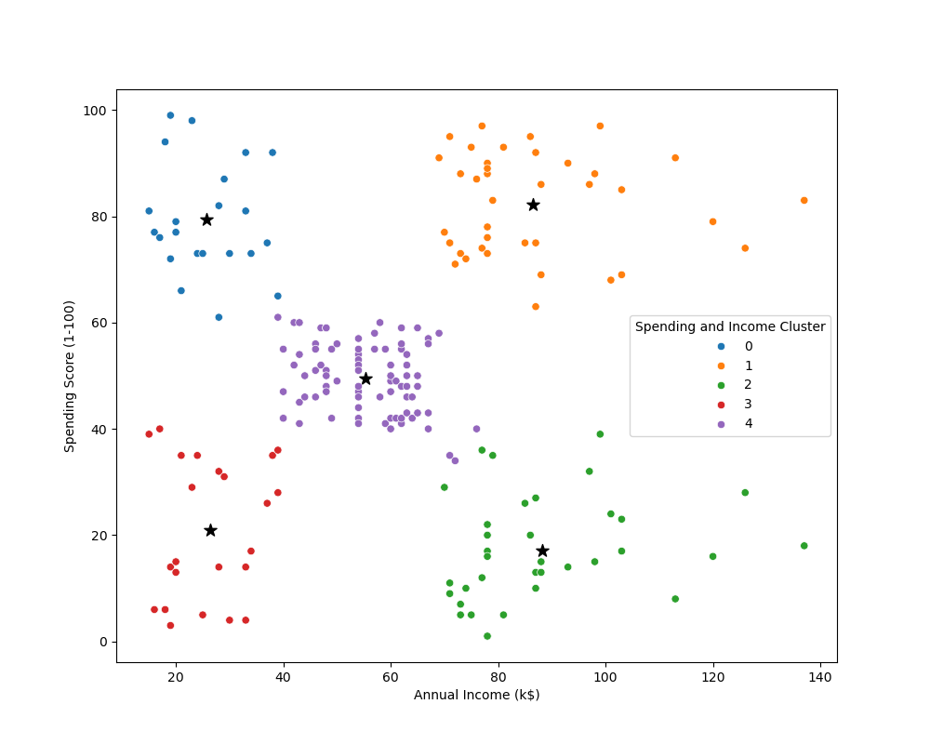

Slide 3
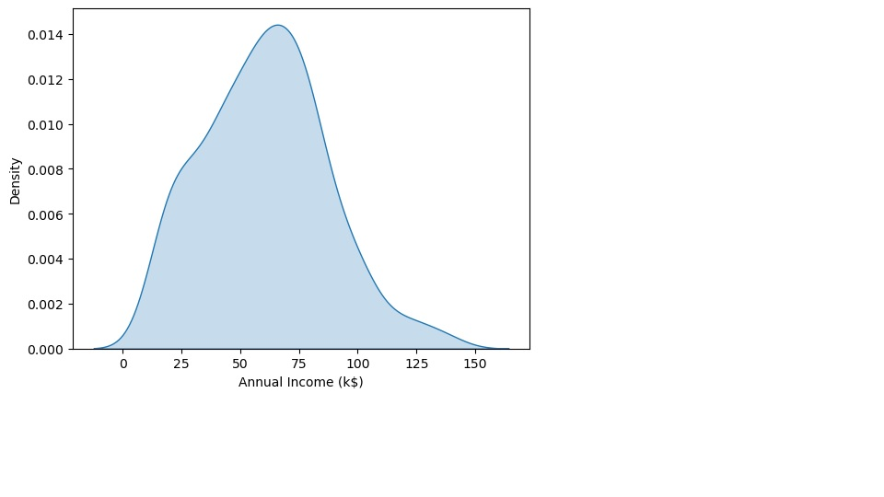
Annual Income

Slide 4
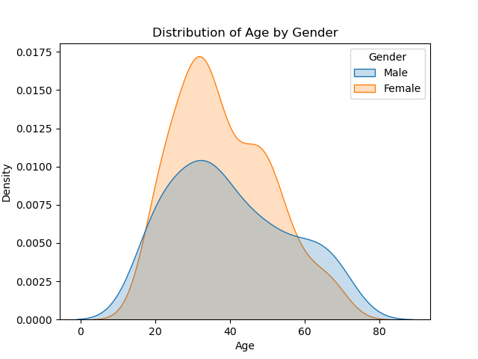
DISTRIBUTION OF AGE BY GENDER

Slide 5
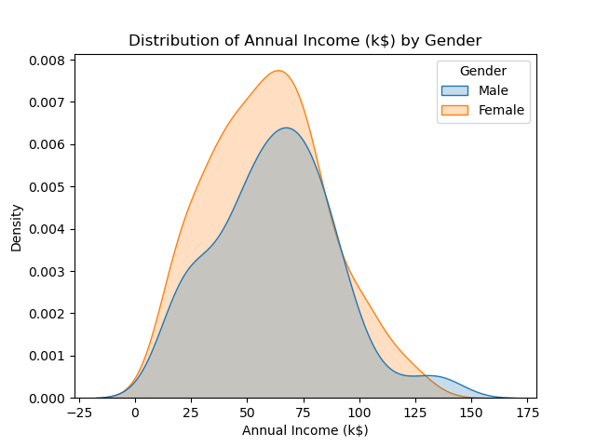
DISTRIBUTION OF ANNUAL INCOME BY GENDER

Slide 6
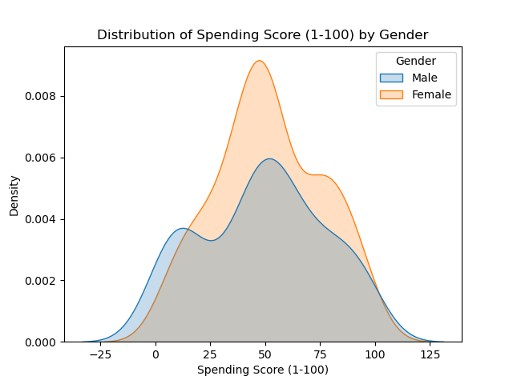
DISTRIBUTION OF SPENDING SCORE BY GENDER

Slide 7
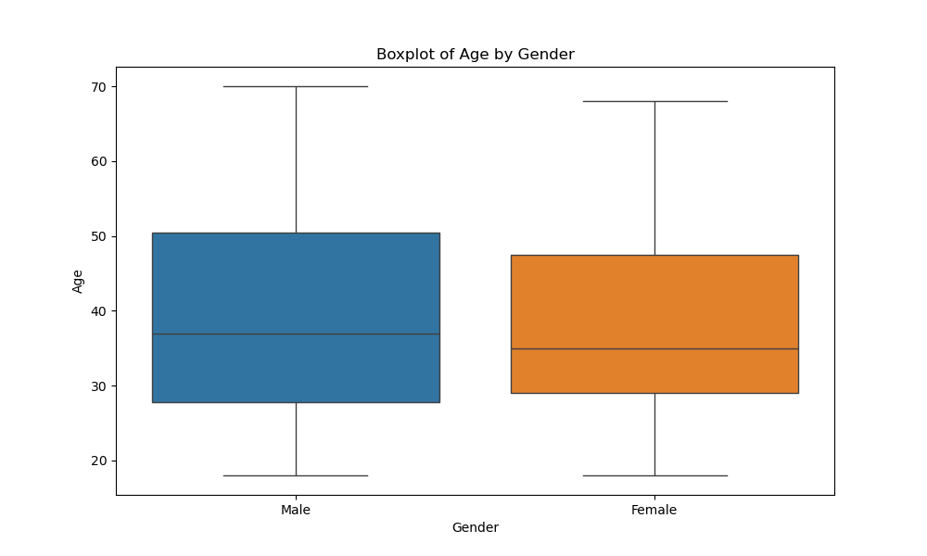
BOXPLOT OF AGE BY GENDER

Slide 8
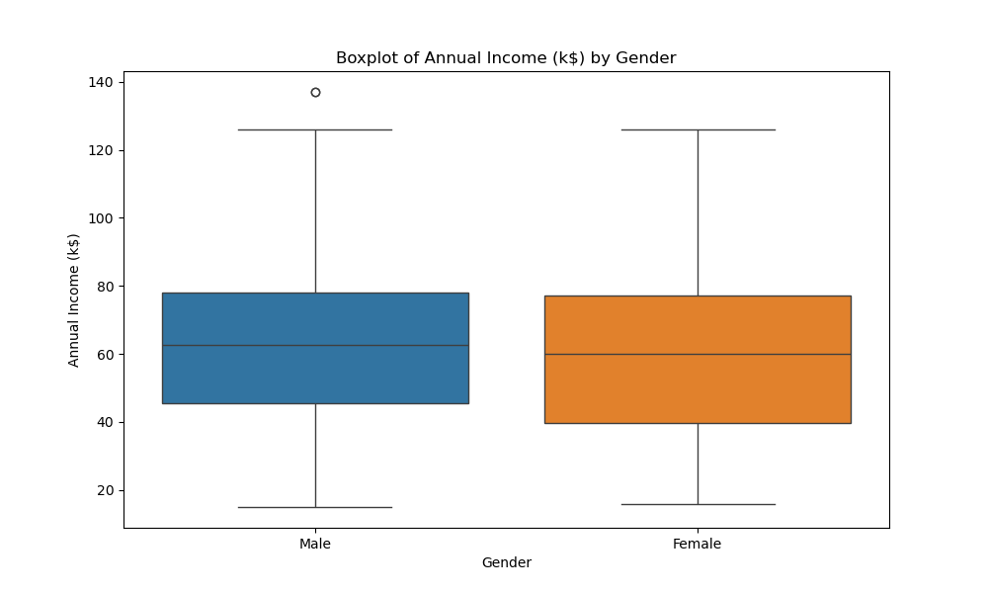
BOXPLOT OF ANNUAL INCOME BY GENDER

Slide 9
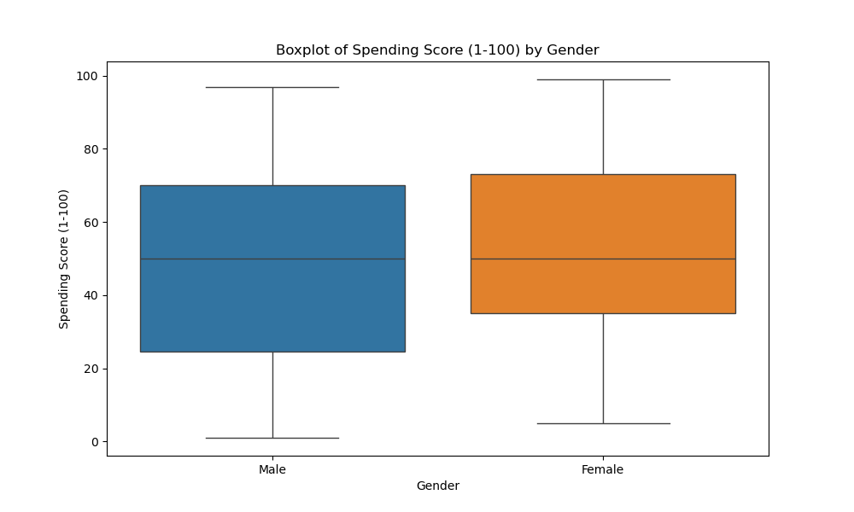
BOXPLOT OF SPENDING SCORE BY GENDER

Slide 10
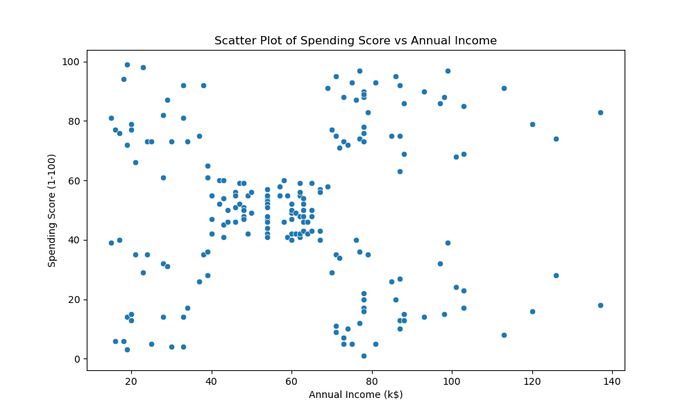
BI-VARIATE CLUSTERING SCATTER PLOT OF SPENDING SCORE VS ANNUAL INCOME

Slide 11
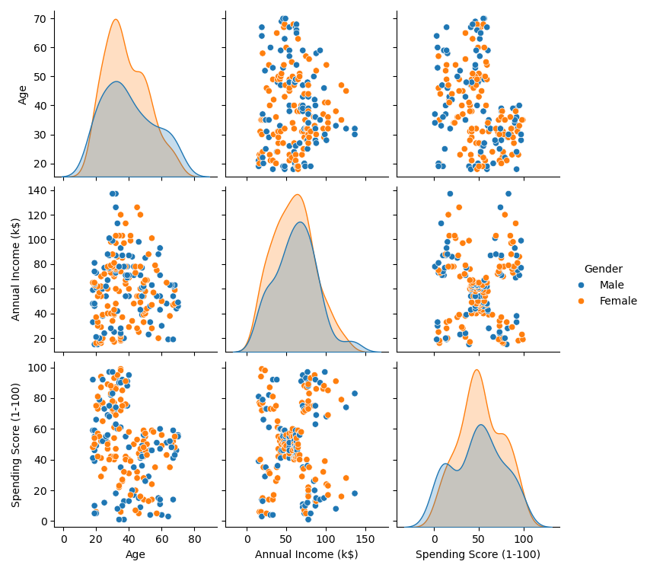
CLUSTERING UNIVARIATE GRIDVIEW WITH HUE

Slide 12
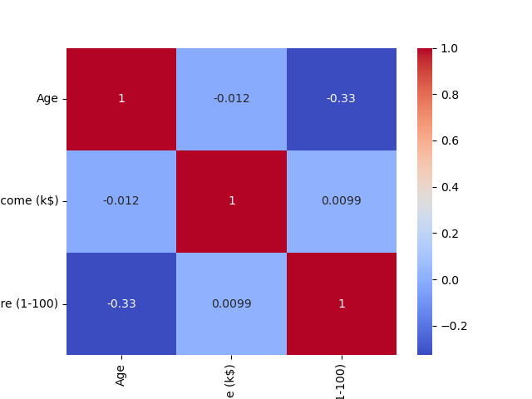
HEATMAP CORRELATION MATRIX WITH NUMERIC FEATURES

Slide 13
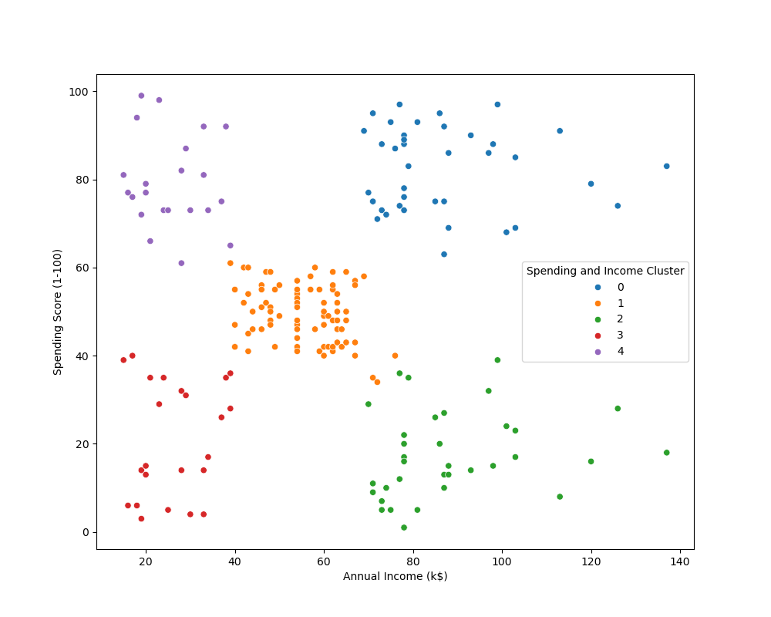
SPENDING SCORE VS ANNUAL INCOME

Slide 14
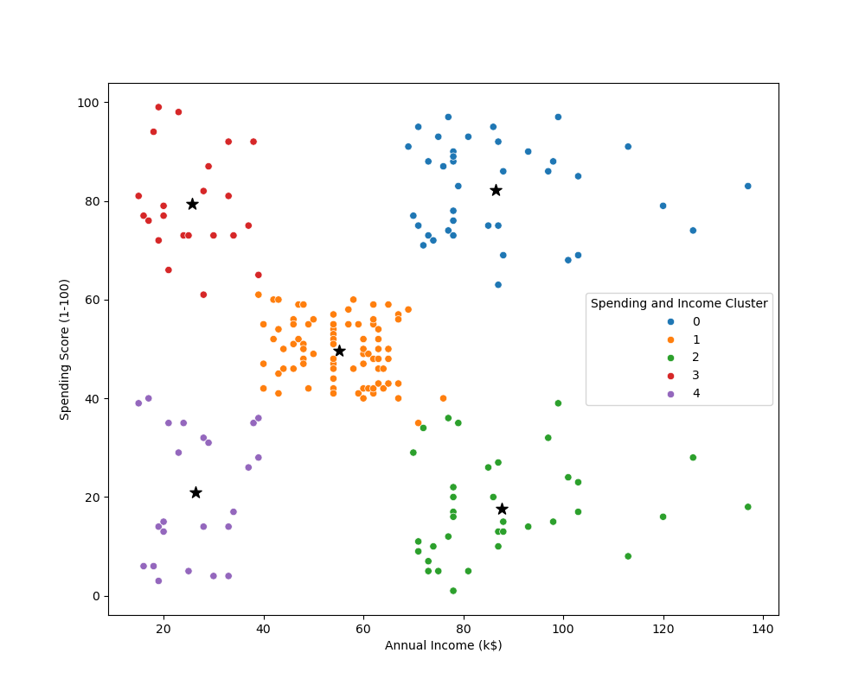
CLUSTERING BI-VARIATE SPENDING SCORE VS ANNUAL INCOME

